Slide 1

A user’s guide to user authentication
Presented by: Christina Nguyen, Michael Bloomquist, Sarah Ramazani, Travis Lamb

Slide 2
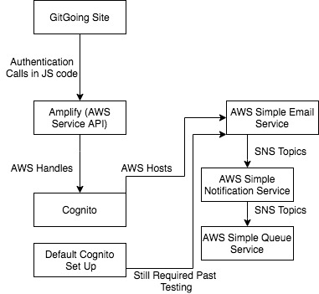
Cognito Site Implementation
React JS
Authentication Calls
Site Needs:
Authentication
Security
AWS Amplify
Amazon Cognito
Email service
Queue service

Slide 3

Introducing Amplify
Amazon Web Services (AWS)
Offers remote cloud services
Amplify
Helps build scalable full-stack applications
Open source libraries
UI Components

Slide 4
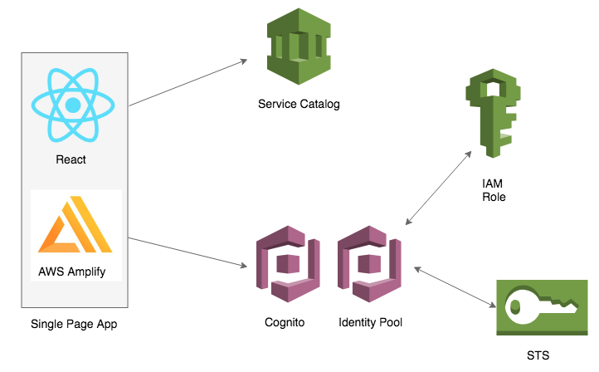
Introducing Cognito
provides authentication, authorization, and user management
2 main parts: user pools and identity pools
User Registration and Security

Slide 5

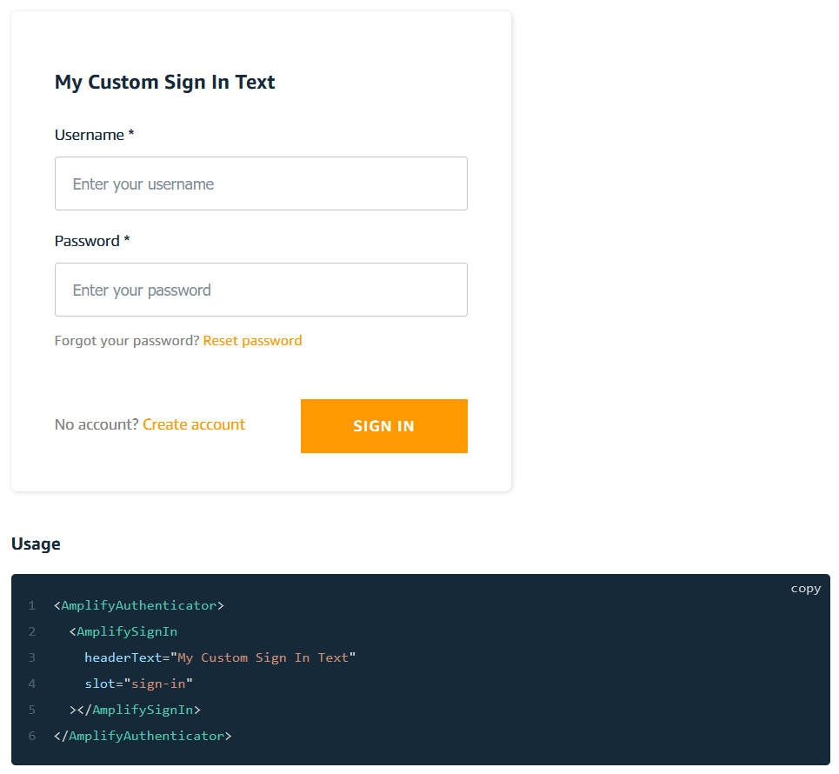
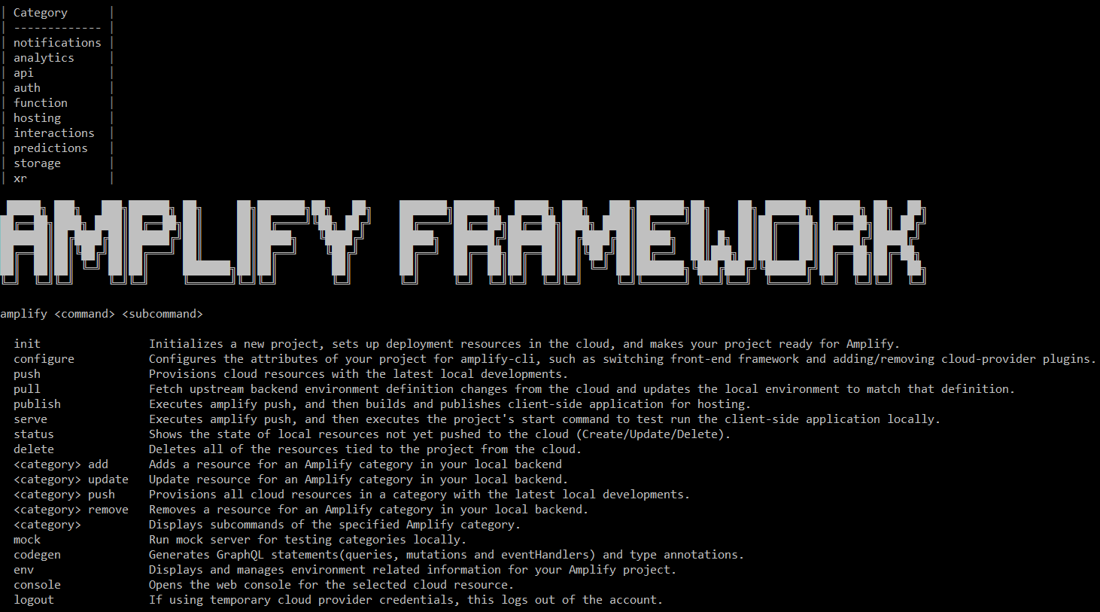
What is Amplify?
An open-source toolset designed to ease the process of setting up AWS backends
Provides the user with a CLI which is used for provisioning backend services
Pre-built UI components allow quick implementation of common systems

Slide 6
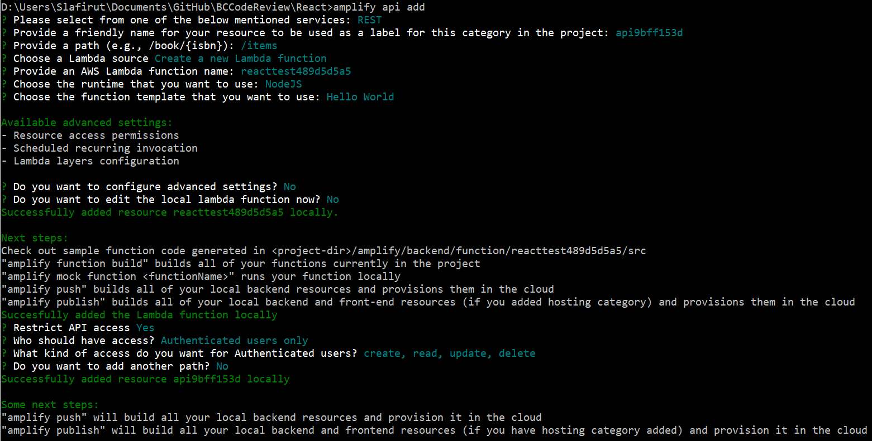
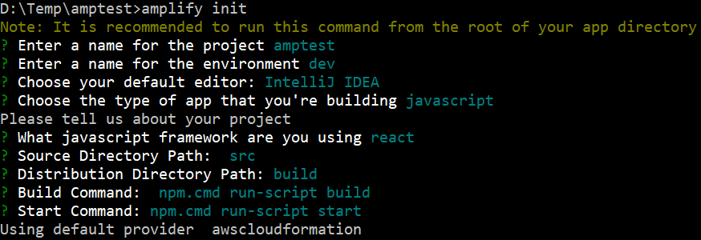
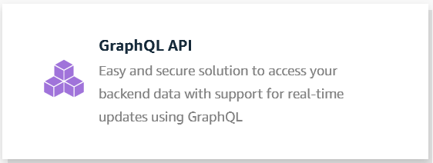
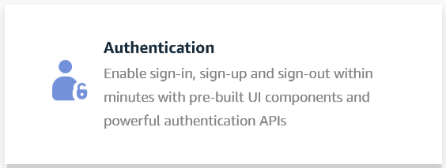
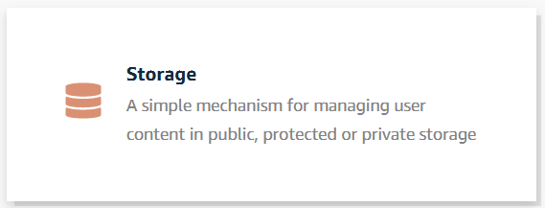
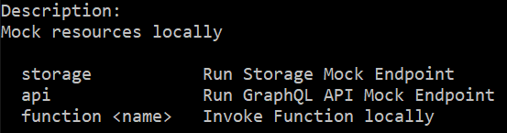
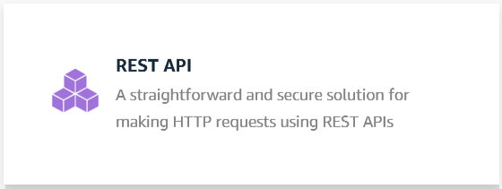
The Amplify CLI
Common commands
amplify init
amplify add
amplify pull
amplify mock
Categories
Auth
API
Storage

Slide 7
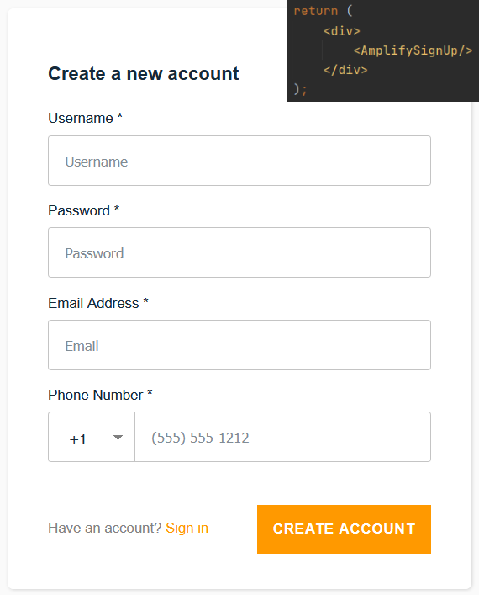
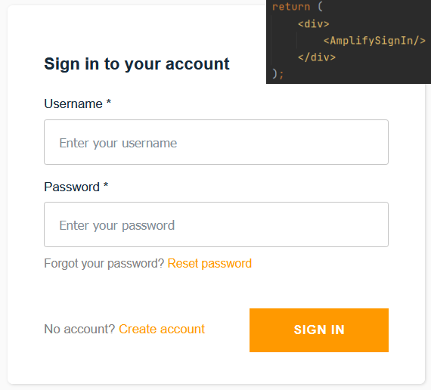
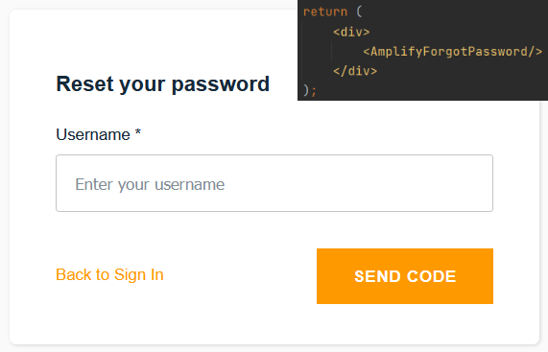



Pre-built UI components
Designed for quick implementation, not necessary
UI components for multiple frameworks (such as React, Angular, Vue)
Auth
AmplifySignUp
AmplifySignIn
AmplifyForgotPassword

Slide 8
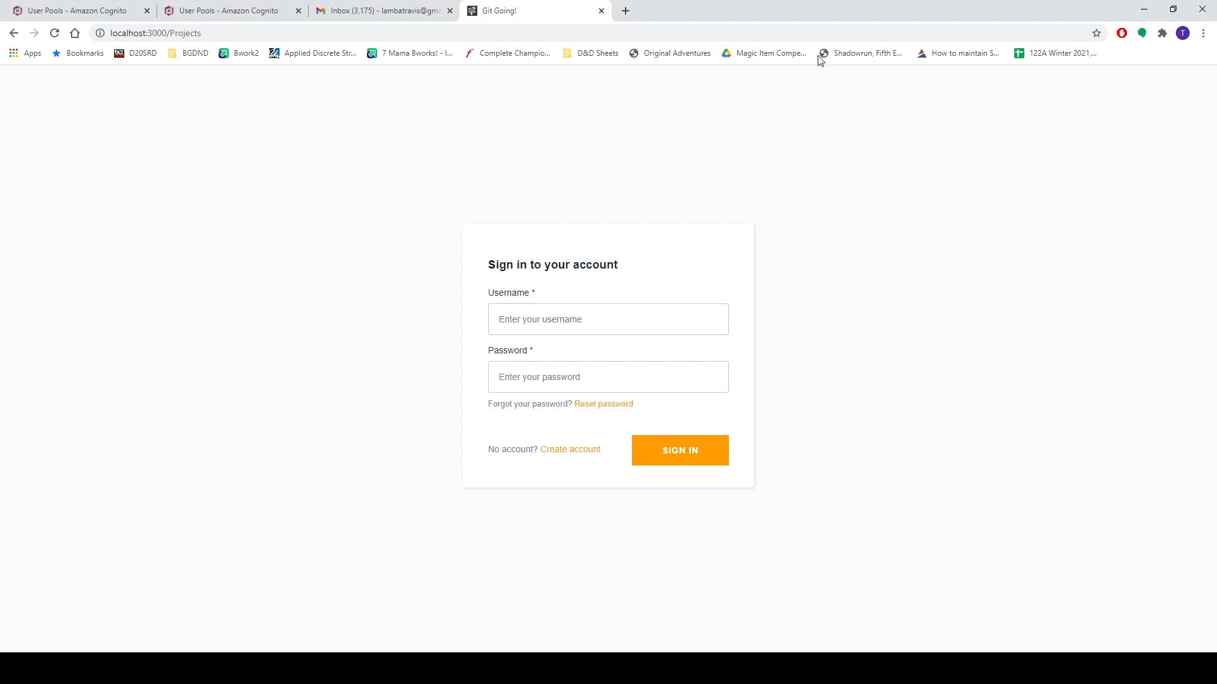
Prebuilt Components vs. Custom Components
Here you’ll see the differences between using Amplify’s prebuilt components and using Amplify’s API calls for custom components.

Slide 9
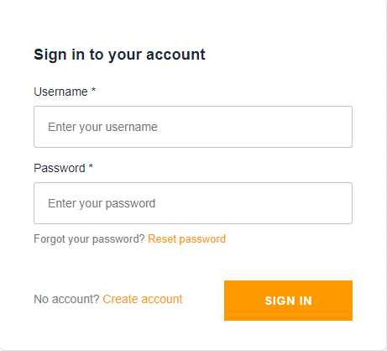

Conclusion
AWS has numerous services that offer a wide variety of utility
Many of the systems play off each other
By focusing on specific tools, one can heavily customize their AWS experience
Despite the ability of Amplify to provide pre-built components, users may also choose to manually implement certain features, allowing for more freedom in development
Documentation is very comprehensive. Don’t get lost.

